Slide 1


Shield_Insurance_Analysis
Shield Insurance -->The company that offers its services across various cities in India with different polacies Catering to different customer needs on Age-Groups through different sales_modes.
This project is structured around three primary Views, each offering distinct functions within the system.
The General_View :
Is provided with Important KPI’s That Caters to the needs and requirements of executive-level users, providing them with comprehensive data.
The 𝐒𝐚𝐥𝐞𝐬_View : This page is specially designed to serve the sales team, offering functionalities that streamline revenue tracking in each sales mode, compare revenues trends month over month
Finally,
The 𝐀𝐠𝐞-𝐠𝐫𝐨𝐮𝐩_View : Focuses on policies and settlements to customers with in each Age-Group, allowing users to explore and understand trends and preferences specific to different age groups.

Slide 2
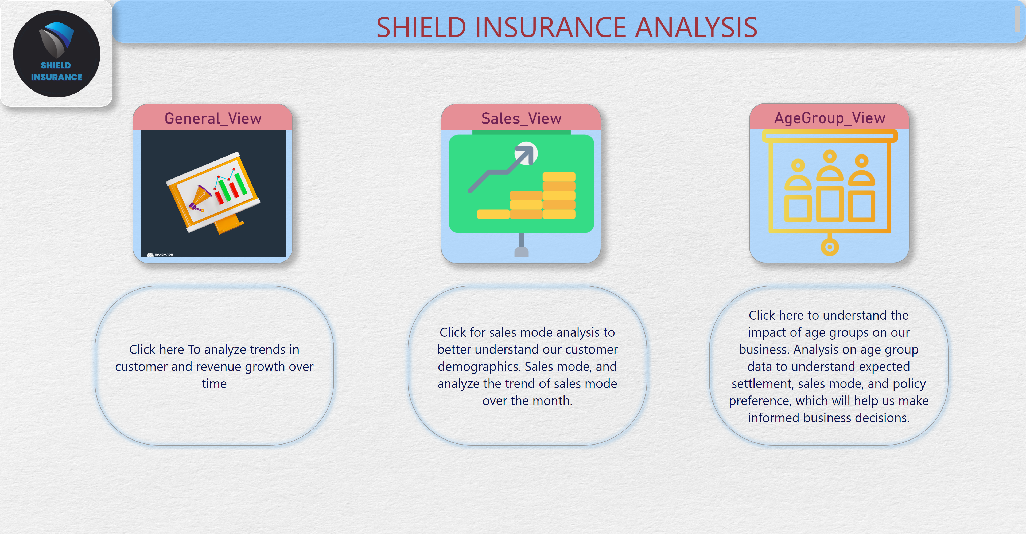
Home
Notes:
textbox
No alt text provided
AgeGroup_View
No alt text provided
Sales_View
No alt text provided
General_View
No alt text provided
shape
No alt text provided
shape
No alt text provided
shape
No alt text provided
image
No alt text provided

Slide 3
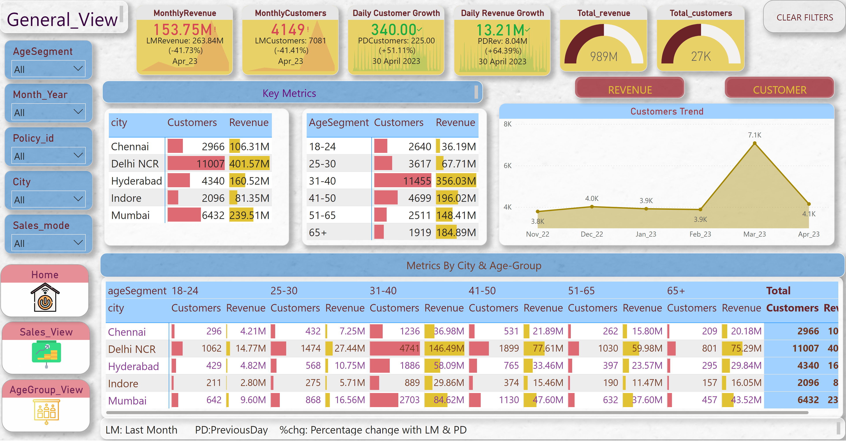
General_View
Notes:
Total_customers
No alt text provided
gauge
No alt text provided
Daily Revenue Growth
No alt text provided
Daily Customer Growth
No alt text provided
Customers Trend
No alt text provided
stackedAreaChart
No alt text provided
actionButton
No alt text provided
actionButton
No alt text provided
MonthlyCustomers
No alt text provided
MonthlyRevenue
No alt text provided
textbox
No alt text provided
textbox
No alt text provided
slicer
No alt text provided
slicer
No alt text provided
slicer
No alt text provided
slicer
No alt text provided
slicer
No alt text provided
Sales_View
No alt text provided
AgeGroup_View
No alt text provided
Home
No alt text provided
actionButton
No alt text provided
textbox
No alt text provided
pivotTable
No alt text provided
pivotTable
No alt text provided
pivotTable
No alt text provided
textbox
No alt text provided

Slide 4
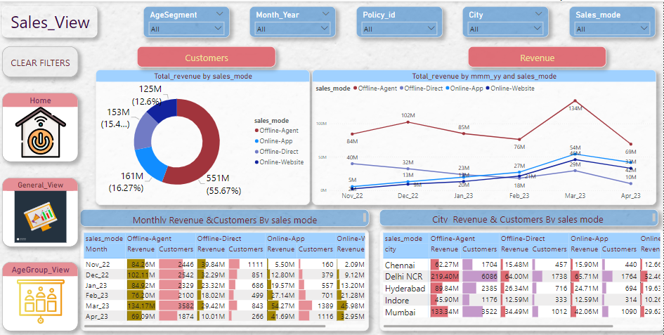
Sales_view
Notes:
pivotTable
No alt text provided
slicer
No alt text provided
slicer
No alt text provided
slicer
No alt text provided
slicer
No alt text provided
slicer
No alt text provided
donutChart
No alt text provided
donutChart
No alt text provided
lineChart
No alt text provided
lineChart
No alt text provided
actionButton
No alt text provided
actionButton
No alt text provided
textbox
No alt text provided
AgeGroup_View
No alt text provided
Home
No alt text provided
actionButton
No alt text provided
General_View
No alt text provided
textbox
No alt text provided
pivotTable
No alt text provided
textbox
No alt text provided

Slide 5
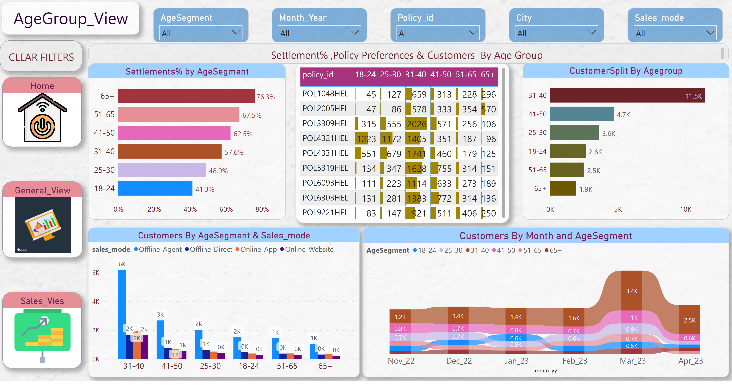
Age_group_view
Notes:
pivotTable
No alt text provided
CustomerSplit By Agegroup
No alt text provided
Settlements% by AgeSegment
No alt text provided
Customers By AgeSegment & Sales_mode
No alt text provided
Customers By Month and AgeSegment
No alt text provided
slicer
No alt text provided
slicer
No alt text provided
slicer
No alt text provided
slicer
No alt text provided
slicer
No alt text provided
textbox
No alt text provided
Home
No alt text provided
actionButton
No alt text provided
General_View
No alt text provided
Sales_Vies
No alt text provided
textbox
No alt text provided

Slide 6


